Slide 1
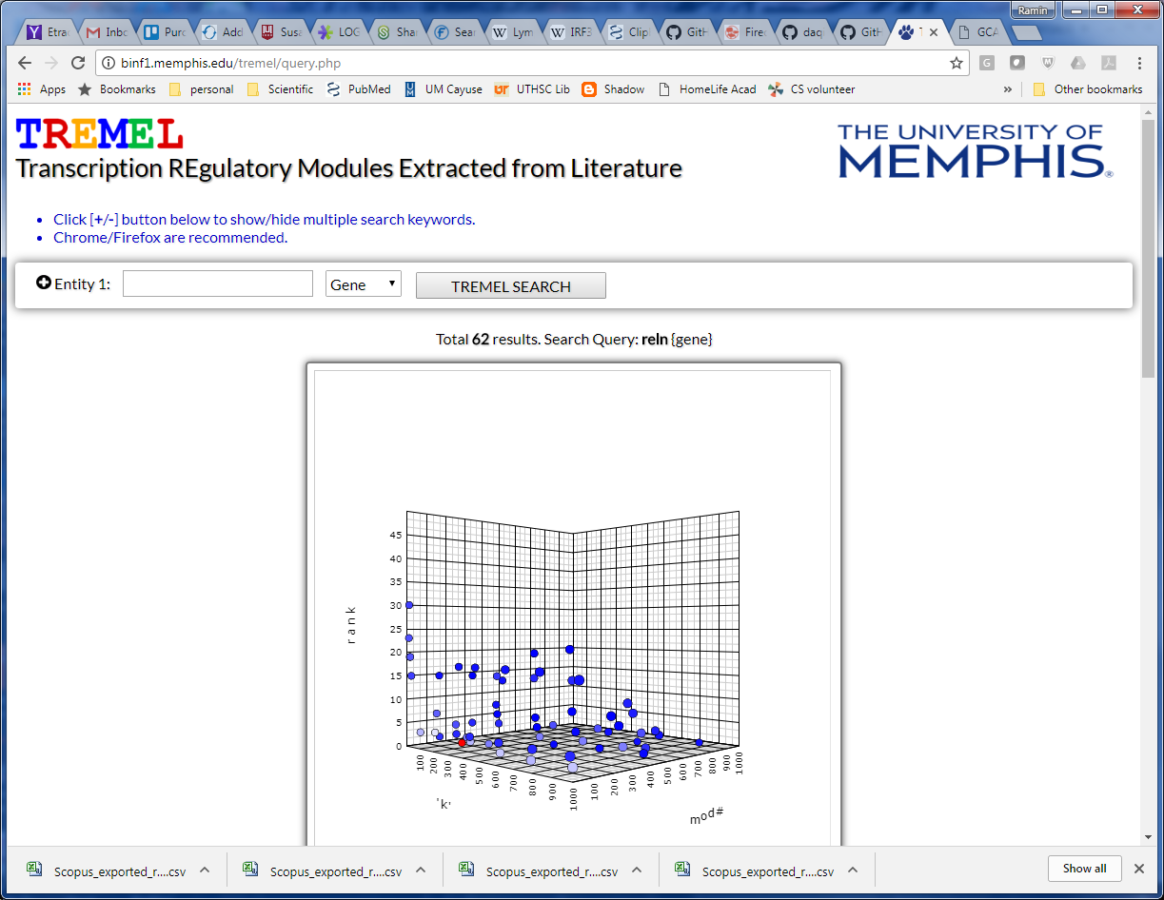
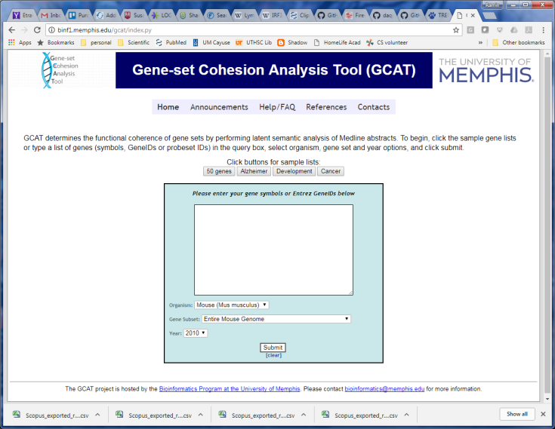
Main Menu
Need a simple menu at the top that shows:
Home | Help | Contact
(see example for GCAT below)

Slide 2
Bubble/hover tips:
Click [ +/-] button to show/hide multiple search fields.
Select entity type: Gene, TF or term
Click to submit query.
Enter official Gene Symbol or keyword
Search :
Select entity type from pulldown menu: Gene, TF, or Term.
Enter gene/TF symbol or any keyword.
Click ‘TREMEL SEARCH’ to submit.
Click [ +/- ] to add additional search fields.
Visualization :
Click on blue point in the plot to display the terms, genes and TFs associated with that module.
The selected dot is displayed in red. Other dots are colored based on the similarity to the selected module.
Rotate the plot by left-click and dragging the mouse.
Customize the plot using right-click menu options.

Slide 3
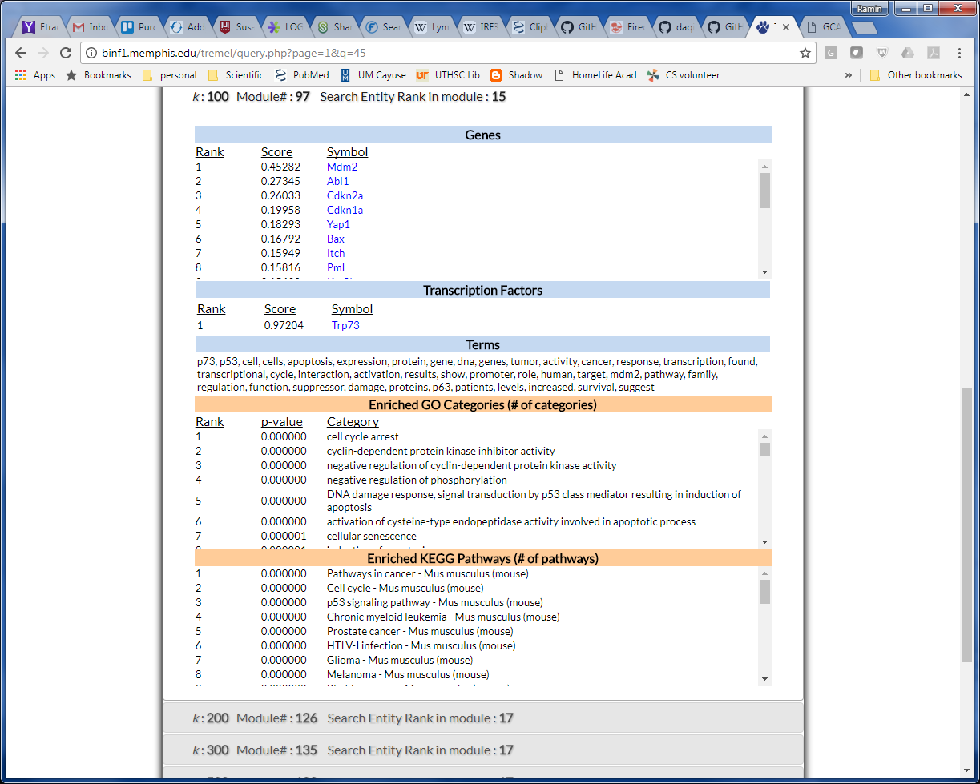
Click symbol to reach Entrez Gene
Click title bar to open/close descriptions

